Slide 1

Module 11: Classes, Objects, & Event Handling
April Crockett, CSC 1300
Notes:
Presentation Slides created by April Crockett, Tennessee Tech University

Slide 2
Module 11 Objectives
You will be able to solve a computing problem using an object.
You will be able to debug and test their code containing objects.
You will be able to identify the difference between structures and objects.
Students will be able to recognize when an algorithmic solution can benefit from the use of multiple threads that communicate via events or similar means of interaction.
Students will be able to implement an algorithmic solution using multiple threads that communicate via events or similar means of interaction.

Slide 3
Introduction to Classes & Objects
An object consists of data plus operations that can be performed on that data.
Example Object: PLANET
data: temperature, distance from sun, distance from earth, revolutions, mass, color
operations:
get distance from sun,
get distance from earth,
get temperature of the planet,
calculate how long it takes to make one complete circle around the sun,
get mass of the planet

Slide 4
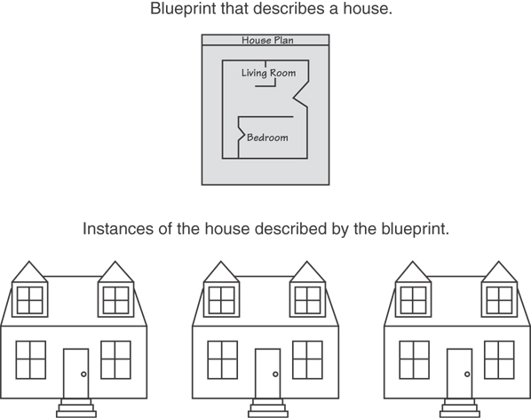
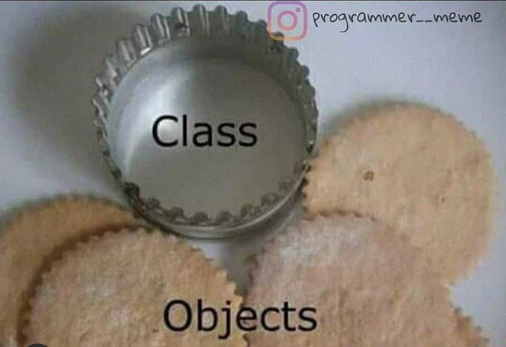
Class Concept
A class is like a cookie cutter and the cookies made with the cookie cutter is like the objects.
A class is like a blueprint and objects are like houses built from the blueprint.

Slide 5
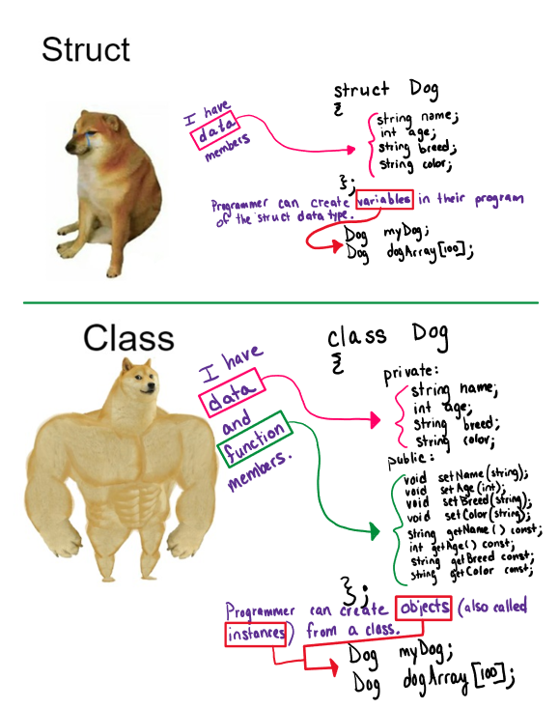
Struct vs. Class

Slide 6
Classes Contain Attributes & Member Functions
attributes: members of a class
member functions: methods or functions of a class
encapsulation: combining data and member functions into an object (and making sure to hide the data…next slide)
THIS IS AN INSTANCE (OBJECT) OF A CLASS
ATTRIBUTES
MEMBER
FUNCTIONS

Slide 7
Data Hiding with Classes
Data hiding: restricting access to certain members of an object.
This is also sometimes called information hiding.
THIS IS AN INSTANCE (OBJECT) OF A CLASS
ATTRIBUTES
OUTSIDE
CODE
MEMBER
FUNCTIONS

Slide 8
Object Reusability with Classes
A real-world program is never written by one person. Every C++ program we have written so far has used objects (cin, cout, string)
Object-oriented programming (OOP) is great because programmers can re-use code more easily….this is called object reusability.
YOUR
CODE

Slide 9
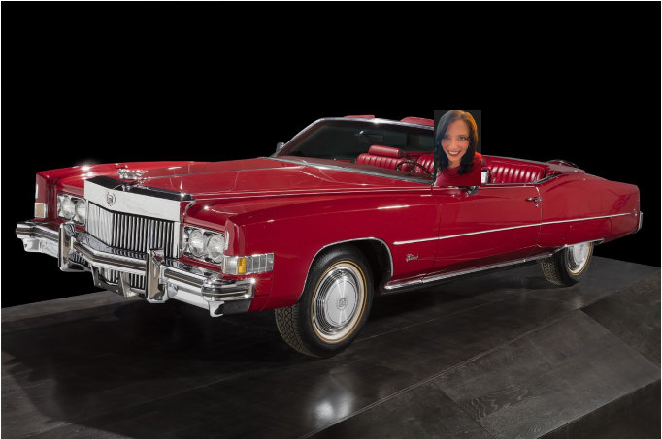
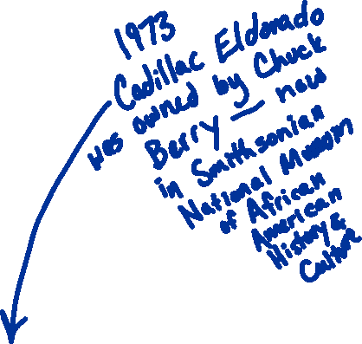
Object Interface & Classes
What do I need to know in order to drive this car?
The car’s user interface!
(steering wheel, gear shift,
gas pedal, brake, ignition, mirrors)
Programmers should separate an object’s interface from its implementation. The user of an object only needs to know the interface.

Slide 10
Class Syntax

Slide 11
Class Declaration
class ClassName {
//class members go here
//which include attributes &
//member functions
};

Slide 12
Defining the Book Class
class Book {
//attributes
private:
int numPages;
string title;
float price;
//member functions
public:
void setNumPages(int);
int getNumPages()const;
};
Notice the member functions inside the class definition are function prototypes (not function definitions).

Slide 13
Create an Object (Instance) of the Book Class
class Book {
//attributes
private:
int numPages;
string title;
float price;
//member functions
public:
void setNumPages(int);
int getNumPages()const;
};
int main()
{
Book myFavBook;
myFavBook.setNumPages(156);
This is called the dot operator.

Slide 14
Private & Public Access Specifiers
class Book {
//attributes
private:
int numPages;
string title;
float price;
//member functions
public:
void setNumPages(int);
int getNumPages()const;
};
This is the “private” access specifier which allows the programmer to DISALLOW direct access to all members declared after this specifier. All attributes should typically be private.
This is the “public” access specifier which allows the programmer to ALLOW direct access to all members declared after this specifier.

Slide 15
More about Access Specifiers
Access specifiers can be listed in any order in a class.
They can appear multiple times in a class
If not specified, the default is private.

Slide 16
Class Member Function Definition
The scope resolution operator :: informs the compiler that this function is a member function of the Book class.
class Book {
//attributes
private:
int numPages;
string title;
float price;
//member functions
public:
void setNumPages(int);
int getNumPages()const;
};
void Book::setNumPages(int num)
{
numPages = num;
}

Slide 17
Class Member Function Definition: const
const informs the compiler that this function will not be modifying the value of any attributes.
class Book {
//attributes
private:
int numPages;
string title;
float price;
//member functions
public:
void setNumPages(int);
int getNumPages()const;
};
int Book::getNumPages() const
{
return numPages;
}

Slide 18

Module 11 In-Class Practice 1
Create a class called IceCream in a header file named IceCream.h.
The IceCream class should have four private variables. Three are strings – cone, flavor & topping. One is a double and will hold the price.
(Don’t forget include guards)

Slide 19
Class Member Functions: Mutators, Accessors, & Private Helpers

Slide 20
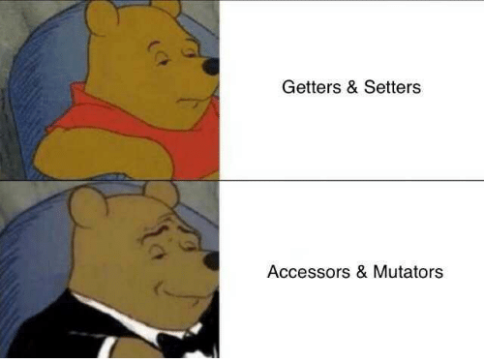
Mutator/Setter Functions
A mutator function is a class member function that changes or mutates member data. Also called setter function.
void Book::setNumPages(int num)
{
numPages = num;
}

Slide 21
Accessor/Getter Functions
An accessor function is a class member function that gets or accesses member data but doesn’t change it. Also called a getter function.
int Book::getNumPages() const
{
return numPages;
}

Slide 22
Private Member Functions
A private member function is defined under the private access specifier.
A private function can only be called by another member function, not outside code.
The private member function is used for internal processing by the class.
int convertStringToInt(string str)
{
return stoi(str);
}

Slide 23

Code Organization Separating Specification from Implementation
Class Specification File
Class Implementation File
Outside Code
Place the class declaration in a header file that serves as the class specification file.
Name the file ClassName.h, for example, Rectangle.h
Place member function definitions in ClassName.cpp, for example, Rectangle.cpp
This file should #include the class specification file. This is called the class implementation file.
Programs that create an object of a class is the “outside code” and must #include the class specification file, and be compiled and linked with the member function definitions

Slide 24
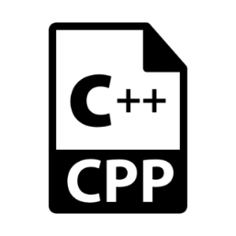
Class Examples
oop.cpp An example where the class declaration (class specification file), class implementation file, and “outside” code that creates an object of the class are all in a single source file.
Rectangle Version 1 (Rectangle.h, Rectangle.cpp, myProg.cpp) An example where the class specification file, class implmenetation file, and “outside” code (myProg.cpp) are in three separate files.

Slide 25
Module 11 In-Class Practice 2
Add four accessor functions and four mutator functions to your IceCream class.
The function prototypes should be in the class declaration file (IceCream.h) and the function definitions should be in a class implementation file named IceCream.cpp.

Slide 26
Constructor Member Functions

Slide 27

Constructors
Member function that are automatically called when an object is created
Purpose is to construct an object – like an initialization routine for the object
Constructor function name is class name
Has no return type
Two types of constructors: default & overloaded

Slide 28
Default Constructors vs. Overloaded Constructors
A default constructor is a constructor that takes no arguments (empty parameter list). Rectangle();
An example function definition: Rectangle::Rectangle(){
width = 0;
length = 0; }
Creating an instance (object) of a class with no arguments calls the default constructor: Rectangle r;
To create an overloaded constructor (a constructor that takes arguments), indicate parameters in the prototype: Rectangle(double, double);
Use parameters in the definition: Rectangle::Rectangle(double w, double len){ width = w; length = len; }
Creating an instance (object) of a class where you pass arguments: Rectangle r(10, 5);

Slide 29
Constructors Examples
Rectangle Version 2 (Rectangle.h, Rectangle.cpp, myProg.cpp)
Sale Version 1 (Sale.h, myProg.cpp)

Slide 30
Module 11 In-Class Practice 3
SAMPLE OUTPUT
Printing the first Ice Cream before attributes are set.
Cone:
Flavor:
Topping:
Price 0.00
Printing the first Ice Cream after calling mutator functions.
Cone: waffle
Flavor: chocolate
Topping: m&m
Price 3.99
Enter your favorite ice cream:
CONE: cup
FLAVOR: cookies and cream
TOPPING: hot fudge
PRICE: $4.99
Printing the Second Ice Cream:
Cone: cup
Flavor: cookies and cream
Topping: hot fudge
Price 4.99
Add two constructor functions (a default constructor & overloaded constructor) to your IceCream class. Also create a printIceCream function for the IceCream class that will print all the attributes to the screen. All function definitions should be in IceCream.cpp.
Create Driver.cpp to do the following:
Create an IceCream object.
Call the printIceCream function.
Call the 4 mutator functions to set the attributes of this object.
Call the printIceCream function.
Ask the user for their favorite cone, flavor, topping, and the price of the ice cream. Then create a 2nd IceCream object, sending the user’s data to the constructor during creation.
Call the printIceCream function.

Slide 31
“this” Implicit Parameter

Slide 32
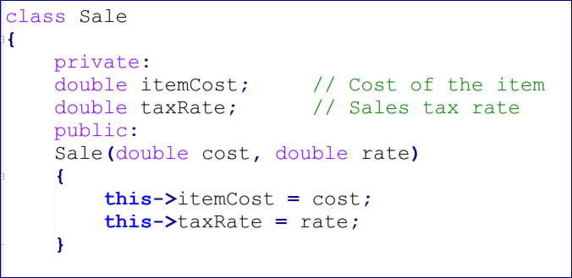
The “this” Implicit Parameter
When accessing an object’s member (either an attribute or a member function), you can use the word “this” with the pointer operator ->. Using “this” could make your code more readable.

Slide 33
Destructor Member Function

Slide 34
Destructors
A destructor is a member function that is automatically called when an object is destroyed
Destructor name is ~classname, e.g., ~Rectangle
Has no return type; takes no arguments
Only one destructor per class, i.e., it cannot be overloaded
If a class constructor allocates dynamic memory, the destructor should release the memory

Slide 35
Class Example with a Destructor
Rectangle Version 3

Slide 36
Event Handling

Slide 37
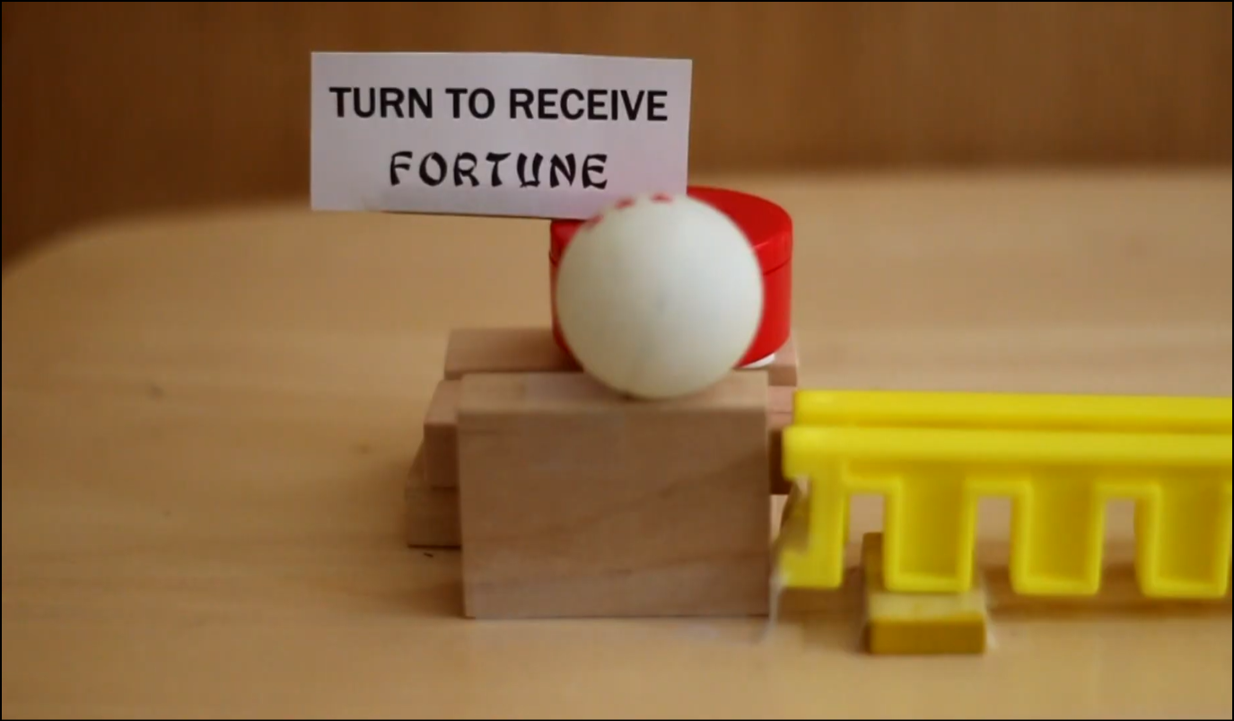
Overly Complicated Machine (open a fortune cookie) An example to show events & responses.
https://www.youtube.com/watch?v=VdSSOAtIrYU&t=1s

Slide 38
An Event in Programming
An event is some action that indicates a user interacting with a program. Examples of events on a GUI:
mouse click
pressing a key on the keyboard
Images from giphy.com/gifs

Slide 39
An Event in Programming Example
A different example from HTML web pages, a webpage finishing loading is also considered an event.
Images from giphy.com/gifs

Slide 40
Response to an Event
When an event happens, something should happen in response to it.
Code must be created to ensure that every event is understood, and the appropriate action fired in response.

Slide 41
Event Handlers
Using HTML as an example, programmers use JavaScript code to react to events such as user’s clicking on website buttons or links or when the webpage finishes loading.
Code that is written that reacts to events are called event handlers.
Event handler code will verify user input, user actions, & browser actions so the appropriate response occurs every time a page loads, when a page is closed, when a user clicks a button, when a user inputs data into a form, and so on.

Slide 42
Examples of Events & Event Handlers
EVENTS
EVENT HANDLERS
A new tab is opened in a browser
Notification pops up on the webpage.
Submit button is clicked on a form
Form is submitted
Mouse click on a screen
Screen background color is changed
Total button is clicked
Math calculation executes and displays result on screen

Slide 43
Synchronous vs. Asynchronous
Synchronous Event Handling
Tasks happen in sequence, blocking each other.
Events are handled sequentially (1 at a time), in order, blocking the program until each event is finished.
Like standing in line at a checkout – each customer must finish before the next one can be served.
Asynchronous Event Handling
Tasks can be scheduled and executed independently, without blocking the program.
The program can keep running while an event handler is scheduled to run later.
This avoids blocking and allows multiple tasks to progress concurrently (at the same time)
Like ordering at a restaurant and then sitting down – your food is prepared in the background while you can do other things until its ready.
Asynchronicity Demonstration: https://cse.unl.edu/~cbourke/PDCatUNL/module-asynch-demo.html

Slide 44
GUIs

Slide 45
Graphical User Interfaces (GUIs)
A graphical user interface (GUI) is a visual interface that allows users to interact with electronic devices with buttons, links, menus, windows, dialogs, and other visual indicators.
A GUI is often used instead of a text-based user interface because of its improved visual experience and understanding for users.

Slide 46
Building Graphical User Interfaces (GUIs) in C++
There is not a built-in library for GUIs in C++, but you can create GUIs in C++ using 3rd party GUI libraries built for C++.
Popular GUI Libraries for C++
gtkmm
Qt
wxWidgets
Dear ImuGui

Slide 47
Overloaded Operators (Advanced Topic in Preparation for CSC 1310)

Slide 48
Overloaded Operators
In the “Other Class Examples” folder. These classes have functions that overload operators.
Student.h – so you can look at what a Student class would look like (to compare to a Student struct). Contains functions to overload some operators (>, <, and <<)
Animal.h – demonstrates a function to overload << and ==.
Song.h – demonstrates an overloaded <<.
Driver.cpp – a program that creates instances of all three classes – Student, Animal, and Song!

Slide 49

END of
Module 11

